Slide 1
U.S. Department of Interior SkillBridge Partner Briefing Briefer: Mr. Cameron Wiley Dyess AFB Community Relations

Slide 2
What is SkillBridge
01
02
Applicable Policy
03
Types of SkillBridge Opportunities
04
Get Started Toolkit
05
OVERVIEW
Service Specific SkillBridge POCs
06
Questions

Slide 3
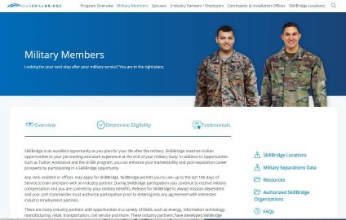
What is SkillBridge
Is an opportunity for Service Members and Military Spouses to gain valuable civilian work experience and employment
During the last 180 days of service, most are between 6 & 21 weeks
Pay and Benefits Provided by DOD for Service Members

Slide 4
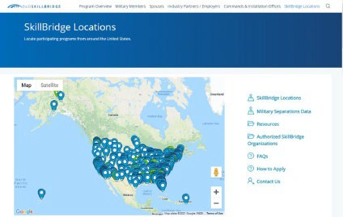
What is SkillBridge (cont)
Approved opportunities are listed on the SkillBridge Website
Interested Service Members can then research opportunities and begin the application process.

Slide 5
Military Spouse Employment
SkillBridge Links to DOD Military Spouse Employment Partnership
Over 130K registered Military Spouses seeking employment
DOD Program specific to Military Spouse Federal Hiring

Slide 6
Types of SkillBridge Programs
SkillBridge programs come in all shapes and
Helpful Tip
sizes, however most partners share these characteristics:
When Considering Potential SkillBridge type:
Capitalize on Experience
Align with Vacancies
Refine Hiring Process
Have clearly defined job training and career development programs designed to enhance opportunities for separating Service members.
Can demonstrate a high probability of a job placement for Service members at program’s end
Support “in demand” industries or occupations with opportunities for professional advancement beyond initial employment.

Slide 7
Types of SkillBridge Programs (Cont)

Slide 8
Getting Started Tool Kit
Use the information and links below to learn what to prepare for as your organization readies for the DoD SkillBridge Program.
This Education/Training Plan Matrix helps your organization create a plan and schedule for your SkillBridge program educational activities such as classroom training, online training, guest lecturers, and assessments.
This Competency Matrix Template helps your organization catalog and define the competencies that are important for your program, participants, and employers. These competencies align to the job role requirements and expectations for which you are training your participants so they can graduate and gain employment. Your program will better meet your employment goals if you align the defined competencies to the learning objectives from each educational asset during its delivery or execution

Slide 9
Getting Started Tool Kit Cont
Use the information and links below to learn what to prepare for as your organization readies for the DoD SkillBridge Program.
This Job Description Template helps you create a job description and profile for the jobs Service members can pursue when they complete your SkillBridge program. Use this template in alignment with the Competency Matrix and the Education/Training Plan to help ensure the success of your DoD SkillBridge program.
This OARPi Tool helps your organization and other key parties identify, document and provide contact information for all personnel who are important for your DoD SkillBridge Program development, management and reporting. We recommend that at the start of your program, your critical stakeholders ask each other how often they would like to be notified of program status.
This questionnaire document contains all the questions that will be asked about your SkillBridge program so you can prepare

Slide 10
Service POCs
Use the Service specific link below and POCs to learn more about each of the Service programs and get questions answered.
Army Website: Army Career Skills Program POC: usarmy.jbsa.imcom-hq.mbx.g1-aces@mail.mil Navy Website: main SkillBridge site POC: “Navy” via How to Participate tab
Air Force Website: Air Force SkillBridge POC: AFPC.DP3SA.SkillbridgeWorkflow@us.af.mil Marine Corps Website: main SkillBridge site POC: “Marine Corps” via How to Participate tab

Slide 11
Name Email Address
Phone Optional
Questions

